Slide 1


TODO LIST
Add Task
Task to do
Completed task

Slide 2

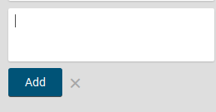
ADD TASK
Streetfight
game

Slide 3


TASK TODO
This Photo CC BY-NC
This Photo CC BY-NC
This Photo CC BY-NC

Slide 4
COMPLETED TASK

